Slide 1



fullstackdatascience.com
Lesson 14 - Python for Data Manipulation
And Visualization
Python
Created by Huydata
DA K6
Lesson 3
huynt@fullstackdatascience.com
1

Slide 2

Learn
About
01/
Pandas
02/
Matplotlib Seaborn
fullstackdatascience.com
2

Slide 3
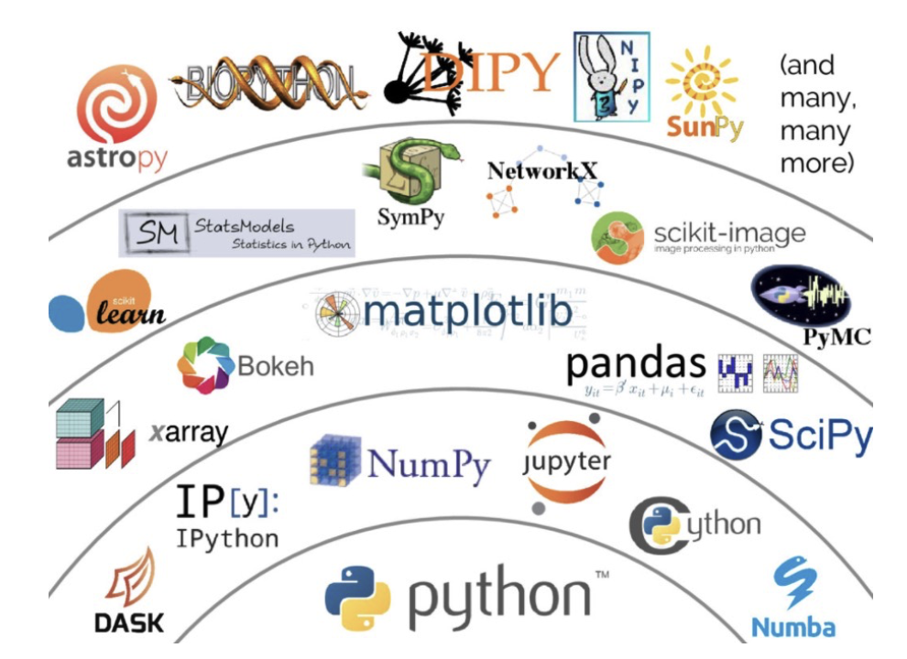
Pandas
Pandas is a powerful library in Python for data processing and analysis.
3

Slide 4
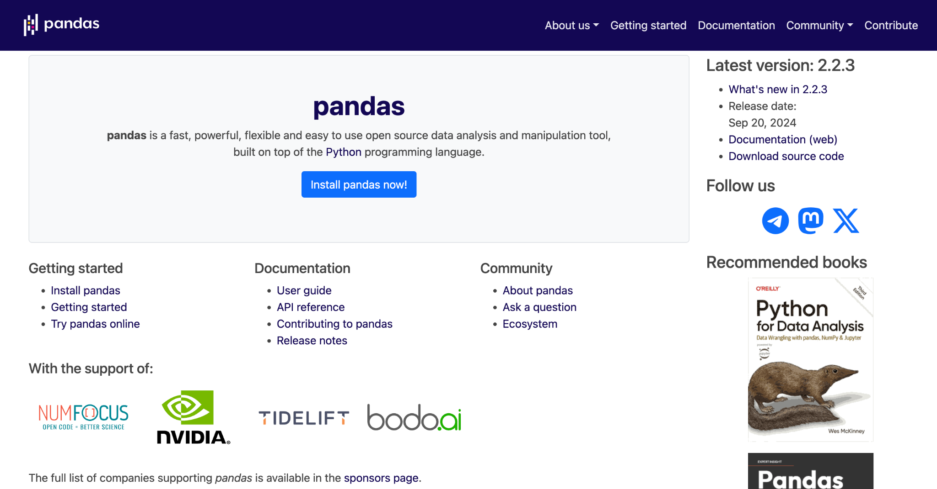
Pandas
https://pandas.pydata.org/
5

Slide 5
Pandas vs SQL
Chức năng | Pandas (Python) | SQL (Structured Query Language)
Cấu trúc dữ liệu | DataFrame, Series | Bảng (Table), Dòng (Row), Cột (Column)
Ngôn ngữ | Ngôn ngữ lập trình (Python) | Ngôn ngữ truy vấn dữ liệu (declarative language)
Lọc dữ liệu (Filter) | df[df['age'] > 25] | SELECT * FROM table WHERE age > 25
Chọn cột (Select columns) | df[['name', 'age']] | SELECT name, age FROM table
Gộp nhóm (Group By) | df.groupby('city').sum() | SELECT city, SUM(value) FROM table GROUP BY city
Gộp bảng (Join) | pd.merge(df1, df2, on='id') | SELECT * FROM A JOIN B ON A.id = B.id
Sắp xếp (Sort) | df.sort_values('age') | SELECT * FROM table ORDER BY age
Xử lý dữ liệu thiếu | df.fillna(0) hoặc df.dropna() | Không hỗ trợ trực tiếp – dùng hàm SQL cụ thể
Thêm cột mới | df['new_col'] = df['a'] + df['b'] | Dùng trong SELECT với phép toán: SELECT a + b AS new_col
5

Slide 6

PRACTICES
4

Slide 7
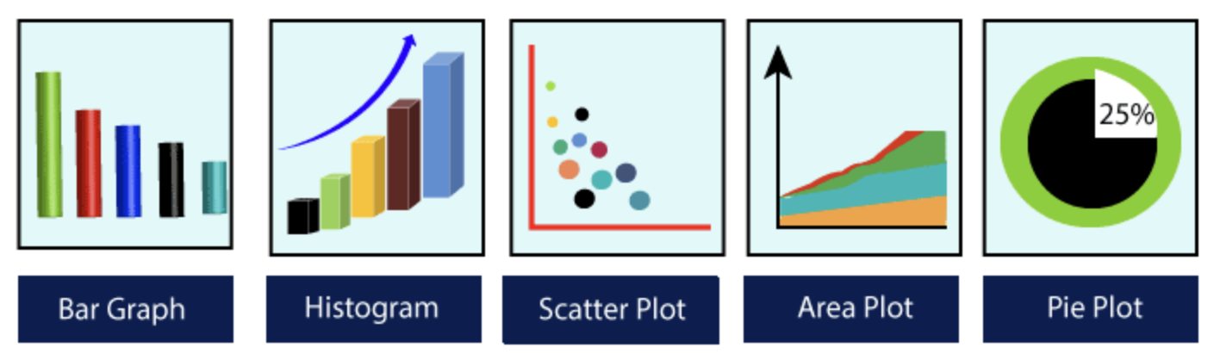
Matplotlib
Seaborn
Most of the default charts in Power BI are available from Matplotlib/Seaborn.
3

Slide 8
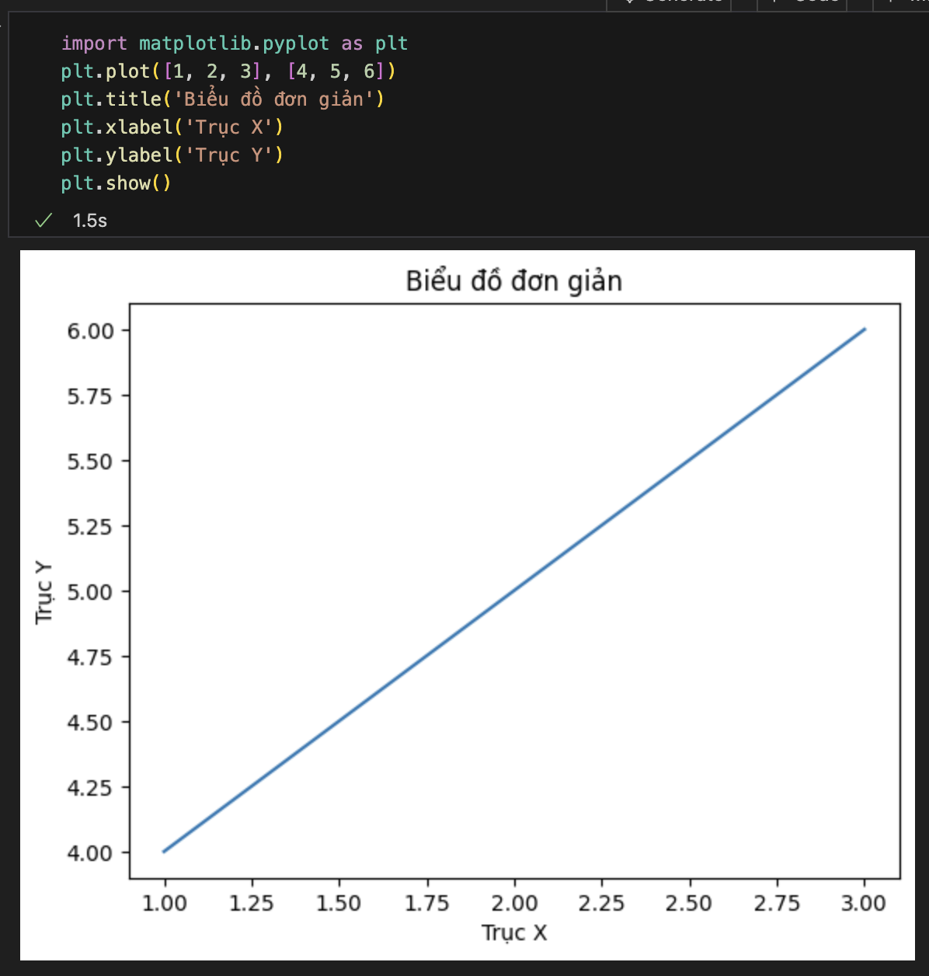
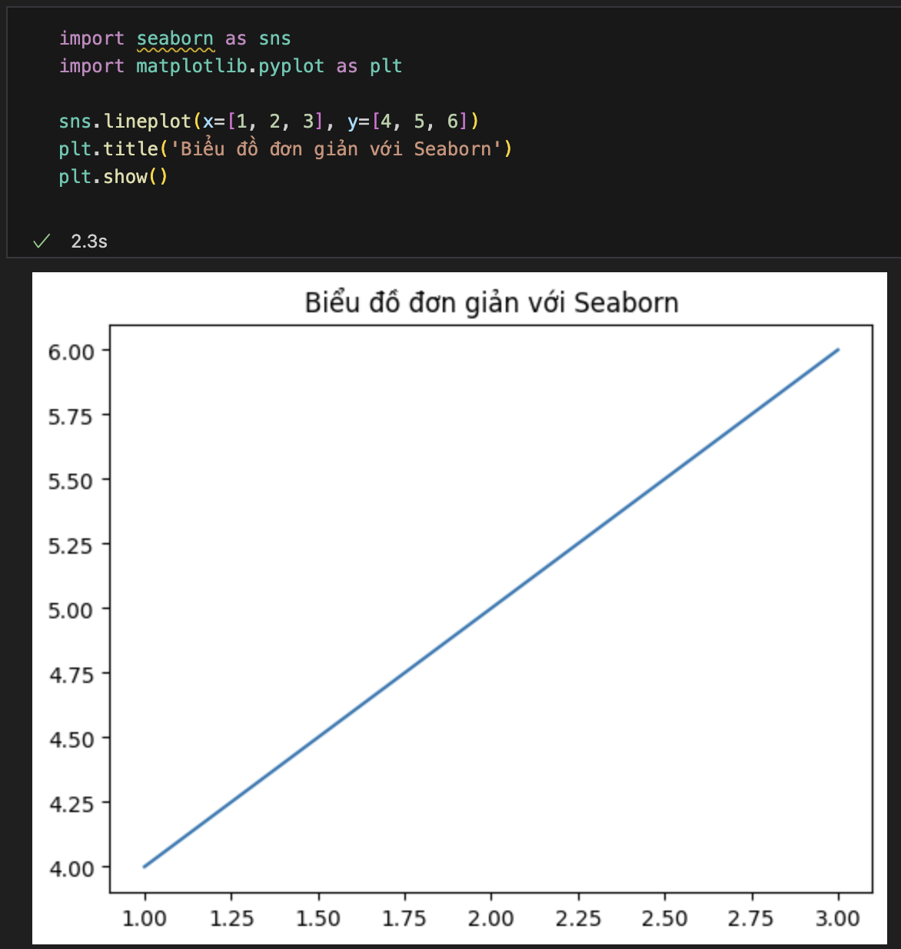
Matplotlib - Seaborn
Matplotlib: Long code and easy to get confused when
you want to create beautiful charts quickly.
Seaborn: Advanced statistical charts available
such as: boxplot, violinplot, heatmap, kdeplot...
5

Slide 9

fullstackdatascience.com
References
https://dataedo.com/samples/html/Data_warehouse/doc/AdventureWorksDW_4/home.html
11

Slide 10





Thank you
096 574 90 25
CREATED BY
Nguyen Tien Huy
info@robusto.ai
fullstackdatascience
huynt@fullstackdatascience.com
Data Manager
https://fullstackdatascience.com/
Hanoi, Vietnam

